Slide 1

PHY 102: Introduction to Physics II
(Spring Semester 2025)
Course Information
Department of Physics
Shiv Nadar University

Slide 2
Lab constitutes 25% of the total marks of PHY102 course. This includes:
PHY 102 LAB
Lab exam: 10%
Lab classes: 15%
For Lab classes: Each experiment carries 15 marks, which comes from the following components:
On experiment + Viva 10 marks
B. Lab Report 05 marks

Slide 3
LAB REPORT
The Lab report should contain:
Aim/Objective of the experiment,
Observation (Data recorded by the student)
Data analysis,
Uncertainty/error analysis,
Results and conclusions.
Precautions
(Details can be found in the Lab Manual shared in Blackboard)

Slide 4
SUBMISSION AND EVALUATION OF LAB REPORTS
For each group, the corresponding instructors will evaluate the Lab reports.
It is very important to compose your lab reports according to the instructions given (previous slide) as every head carries marks. For example, out of 5 marks:
1 mark: Aim, Theory (Working formula + explanation)
3 marks: Experimental data + graph
1 mark: Error analysis + Conclusion

Slide 5
Experiment#1
Error analysis
PHY102 laboratory

Slide 6
Motivation
Performing the experiment and collecting data is the beginning of the process of completing an experiment in science.
Error analysis is the study and evaluation of uncertainty in a measurement.
A result comprises of its value and some information on the “quality” of the result.
Precision – How reproducible
Accuracy – How close is it to the “true” value
“Error” (Uncertainty)
Note : Not all measurements have errors. If asked how many people there are in a room, one can give an exact number as an answer.

Slide 7
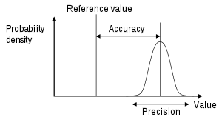
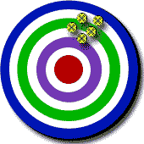
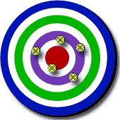

Accuracy and Precision
Measurements
True Value
High Precision
Low Accuracy
Low Precision
High Accuracy
High Precision
High Accuracy

Slide 8
Types of Errors
Systematic
Random
Due to built-in error in
the instrument either in
design or in calibration.
e.g. If the pointer in a stop watch is slightly bent so that it reads 1s instead of 0 seconds and you don’t notice this and start the clock and stop the clock at 10s mark, then you have taken the time period for only 9 s. This would be a systematic error in your result.
Repeated measurements
would not show a spread
in this error.
These lead to a spread or distribution of results on repetition of the particular measurement.
They may arise from fluctuations in either the physical parameters due to the statistical nature of the
particular phenomenon or the judgement of the experimenter,
e.g. variation in response
time or estimation in scale reading.

Slide 9
Reducing uncertainty
Taking repeated measurements reduces the uncertainty of a measurement.
Mean value:
An experiment were repeated many, say N, times to get x₁, x₂, …, x_{k}, …x_{N} (N measurements of the same quantity, x)
The best estimate of the true value of x is then the
mean value of these measurements :
𝑥̅=(𝑥₁+𝑥₂+⋯+𝑥_{𝑘}+⋯+𝑥_{𝑁})/N

Slide 10
Measuring errors:
There are several different ways the distribution of the measured values of a repeated experiment such as discussed above can be specified.
Maximum Error : The maximum and minimum values of the data set, x_{max} and x_{min}, could be specified. In these terms, the quantity,
Δ𝑥_{𝑚ax}=(𝑥_{𝑚ax}−𝑥_{min})/2 is the maximum error.
Probable Error : Probable error, Δx_{prob}, specifies the range 𝑥̅±Δ𝑥_{prob}, which contains 50% of the measured values.
Average Deviation : The average deviation is the average of the absolute values of differences from the mean,
Δ𝑥_{AV}=Σ|𝑥_{𝑘}−𝑥̅|/𝑁
Standard Deviation :
We will use the standard deviation

Slide 11
Reporting the measurement
Therefore any measurement is written down
as :
Where,
Standard deviation on mean
Standard Deviation

Slide 12
Propagation of Errors
If a variable z=z(a₁, a₂, …, a_{N}) depends on variables a₁, a₂, …, a_{N}, which have independent errors (Δa₁, Δa₂, …, Δa_{N}), then the uncertainty in z is given by :
Few Examples :
Z = A + B Δ𝑍=√(Δ𝐴)²+(Δ𝐵)²
Z = A - B Δ𝑍=√(Δ𝐴)²+(Δ𝐵)²
Z = nA (n is an exact number) Δ𝑍=|𝑛|Δ𝐴

Slide 13
Significant figures:
Non-zero digits or zeros between a number are significant.
549 – 3 sig. figs.
1.892 – 4 sig. figs.
4023 – 4 sig. figs.
For decimal’s zeros to the left of the first non-zero digit are not significant.
0.000034 – 2 sig. figs. Write
As 3.4 x 10⁻⁵
For decimal’s zeros to the right of a non-zero digit are significant.
2.00 – 2 sig. figs.
0.050 – 2 sig. figs. (5.0 x 10⁻²)

Slide 14
Rules to express uncertainty
The last significant figure in any result should be of the same order of magnitude (i.e. in the same decimal position) as the uncertainty.
The uncertainty should be rounded to one or two significant figures.
9.82 ± 0.02 9.82 ± 0.02385
10.0 ± 1.5 10.0 ± 2
4 ± 1 4 ± 0.5

Slide 15
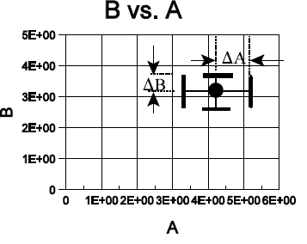
Expressing uncertainty
A result is quoted as : A±∆A
This means that the “true value” lies between
a maximum value of A + ∆A and a
minimum value of A - ∆A
Also ,quote the relative error and percent error :
Relative error = ∆A/A
Percent error = (∆A/A)*100 %
Plotting errors on graphs :

Slide 16
Graphing your results
If the slope or intercept of a line on a plot is the required calculated value (or the required value is calculated from these values) then the uncertainty of the slope and intercept will also be required.
First draw the best line possible, and then draw the two lines that just barely pass through the data.

Slide 17
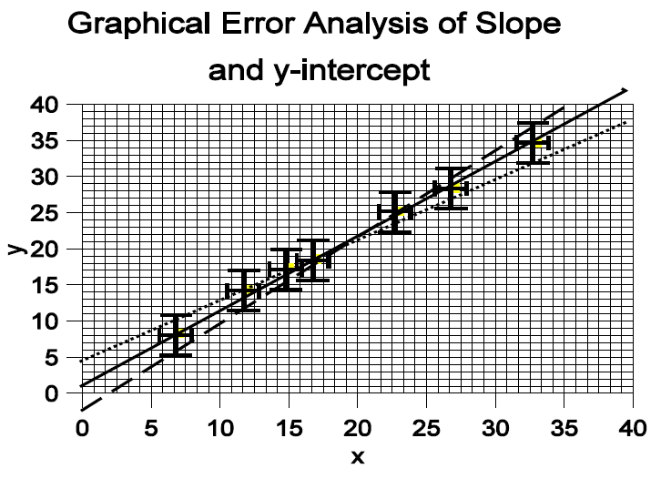



Fit to function
Final Result

Slide 18
Log scale/Linear scale
Everyone is familiar with linear scales
Log (Logarithmic) scale is a scale of measurement that displays the physical quantity using intervals corresponding to orders of magnitude, rather than a standard linear scale.
Each unit increase on the logarithmic scale represents an exponential increase in the underlying quantity for the given base (10, in this case). So, we go as 1, 10, 10^2, 10^3 and so on..
Presentation of data on a logarithmic scale can be helpful when the data covers a large range of values.

Slide 19
A semi-log graph

Slide 20
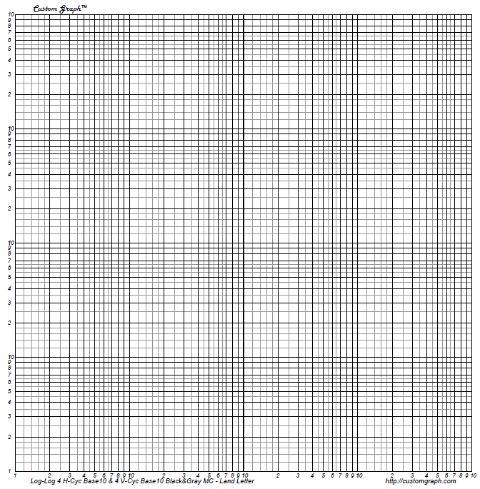
A log-log graph

Slide 21
Assignments (Error analysis and Graphing)
To determine the diameter of a metal wire.
To determine the diameter of a coin.
Plot the given data on a semi-log and
log-log graph paper

Slide 22
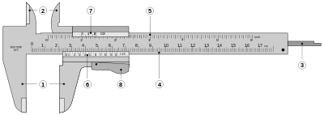
Vernier Callipers
MSD = Main scale small division,
VSD = Vernier scale division
Least count = 1 MSD/(Number of VSD)
Note : Find out the least count of EVERY instrument before
Starting your readings.

Slide 23
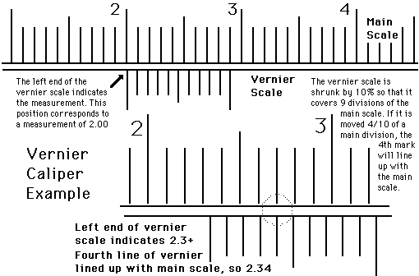
Reading the vernier caliper

Slide 24
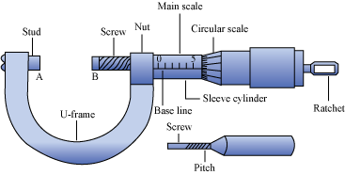
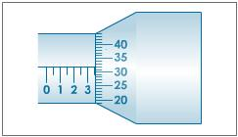
Screw Gauge
Least count = Pitch (Distance moved in one revolution/(Number of Divisions) =
0.5 mm/50 = 0.01 mm
Reading = Linear Scale reading + (coinciding circular scale x least count)
= 3.5 mm + (32 x 0.01)
= 3.5 + 0.32
= 3.82 mm

Slide 25
Assignment-I, the leaky water bucket :
The time we have recorded the times at which the level in a
cylindrical water “bucket” passed each centimeter mark on
the side of the cylinder. Analyze the data. (Use Semi-Log)
Height time
(cm.) (Sec.)
18 0
17 5
16 10
15 14
14 19
13 25
12 31
11 37
10 43
9 51
8 60
7 110
6 121
5 134
4 150
3 211
2 246
1 345

Slide 26
Assignment-2: Light intensity vs distance from a small source
The measurements of the light intensity (brightness) at a detector that is
moved farther and farther from the light source is performed. One has to analyze
the data. He knows that light from a “point” source should obey the
“inverse square law,” a power law and wants to evaluate using log-log paper.
Distance Intensity
(cm.) (ft cndls)
± 0.2 cm ±5%
5 60 (10¹)
10 16.0
15 7.4
20 4.3
30 2.1
40 1.3
60 0.74
80 0.55 (10⁻²)

